Slide 1

Exploratory Data Analysis on
AMEO Data
By
Daliparthy Sumukha Kavya

Slide 2
Introduction
Description of Data:
The dataset provides detailed candidate information, including unique identifiers (ID), annual salaries (Salary), dates of joining (DOJ) and leaving (DOL) the company, job titles (Designation), locations (JobCity), gender (Gender), and dates of birth (DOB).
Academic data includes grades in grade 10 (10percentage) and grade 12 (12percentage) exams, respective school boards (10board, 12board), college details (CollegeID, CollegeTier), degree pursued (Degree), and specialization (Specialization).
AMCAT test scores cover English, Logical, and Quantitative sections (English, Logical, Quant), a domain module score (Domain), and engineering sections (ComputerProgramming, ElectronicsAndSemicon, ComputerScience, MechanicalEngg, ElectricalEngg, TelecomEngg, CivilEngg).
Personality test scores include Conscientiousness, Agreeableness, Extraversion, Neuroticism, and Openness_to_experience.
Geographical details encompass college city ID and tier (CollegeCityID, CollegeCityTier), the state where the college is located (CollegeState), and the graduation year (GraduationYear) for Bachelor’s degree.
Objective:
The objective is to predict the salary (Annual CTC offered) based on the given independent variables such as cognitive skills, technical skills, personality traits, demographic features, educational background, and job-related details.
This is to be approached by Exploratory Data Analysis (EDA) on understanding the characteristics of the dataset and identifying potential relationships between the independent variables and the target variable (Salary).

Slide 3
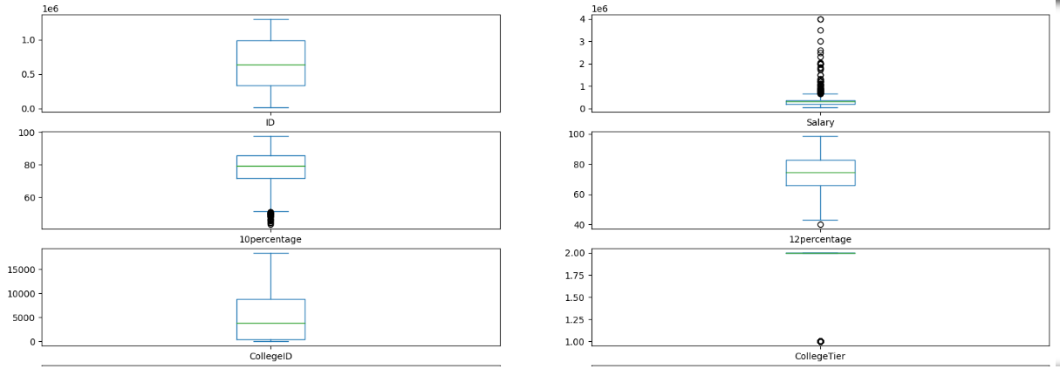
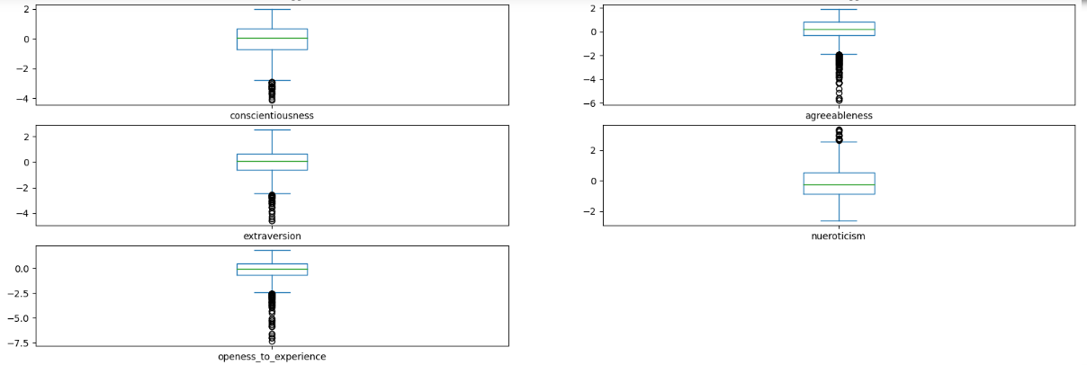
Univariate Analysis
Observations:
Salary Distribution:
The salary ranges from 35,000 to 4,000,000 with a mean of approximately 307,700.
The median salary is 300,000, indicating that half of the individuals earn below this amount and half earn above it.
The standard deviation is about 212,700, suggesting a relatively wide dispersion of salaries around the mean.
Educational Performance:
The 10th and 12th percentages have means around 77.9 and 74.5 respectively, with standard deviations of approximately 9.9 and 11.0.
The mean college GPA is 71.5 with a standard deviation of around 8.2.
In the 10th percentage, there are outliers where the percentage is less than 60% indicating that some individuals had the percentage below 60%.
In the 12th percentage there is a single outlier where the percentage of the individual is less than 40%.
Personality Traits:
Personality traits such as conscientiousness, agreeableness, extraversion, neuroticism, and openness to experience are measured on scales with different ranges.
For example, conscientiousness ranges from approximately -4.13 to 1.99, with a mean close to 0 and a standard deviation of about 1.03.
These traits show varying levels of dispersion around their means, with agreeableness having a relatively high standard deviation compared to others.

Slide 4
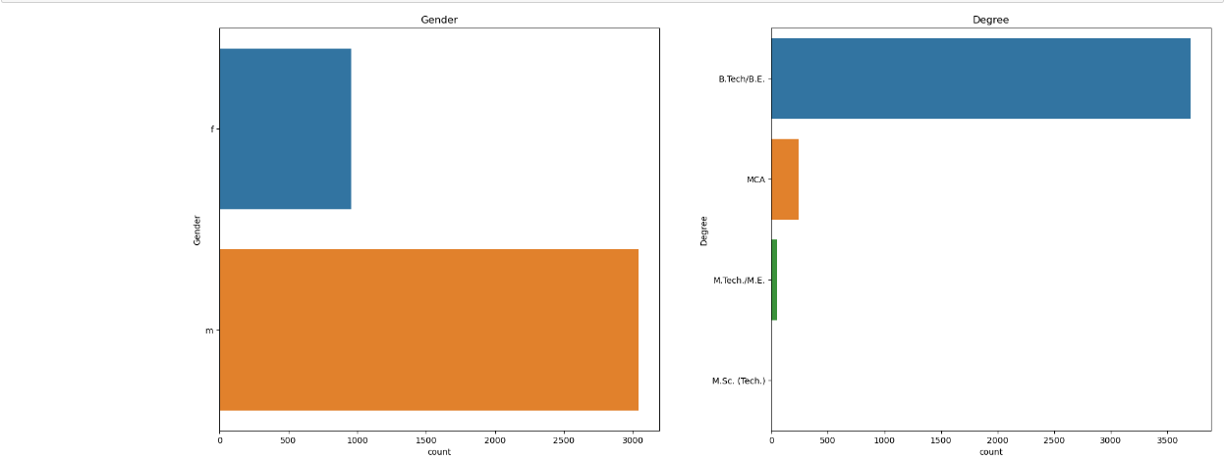
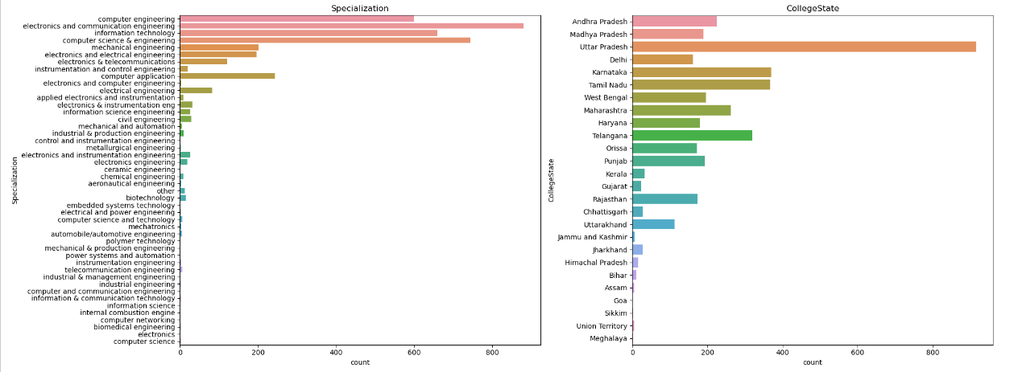
Univariate Analysis
Observations:
Gender Distribution:
There are two unique genders: 'm' and 'f'.
The majority of individuals (about 76.1%) are male ('m'), while approximately 23.9% are female ('f').
Degree Distribution:
There are four unique degrees: 'B.Tech/B.E.', 'MCA', 'M.Tech./M.E.', and 'M.Sc. (Tech.)'.
'B.Tech/B.E.' is the most common degree, constituting about 92.5% of the dataset.
'MCA' (Master of Computer Applications) is the next most common degree, making up around 6.1% of the dataset.
'M.Tech./M.E.' (Master of Technology/Master of Engineering) and 'M.Sc. (Tech.)' (Master of Science in Technology) are less common, together comprising only about 1.4% of the dataset.
Specialization Distribution:
There are 46 unique specializations.
The most common specializations include 'electronics and communication engineering', 'computer science & engineering', 'information technology', and 'computer engineering'.
'electronics and communication engineering' is the most prevalent specialization, followed by 'computer science & engineering' and 'information technology'.
College State Distribution:
There are 26 unique states where colleges are located.
The top states represented in the dataset are Uttar Pradesh, Karnataka, Tamil Nadu, Telangana, and Maharashtra.
Uttar Pradesh has the highest representation, followed by Karnataka and Tamil Nadu.

Slide 5
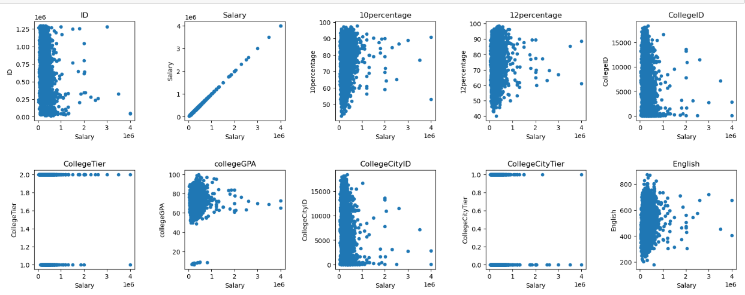
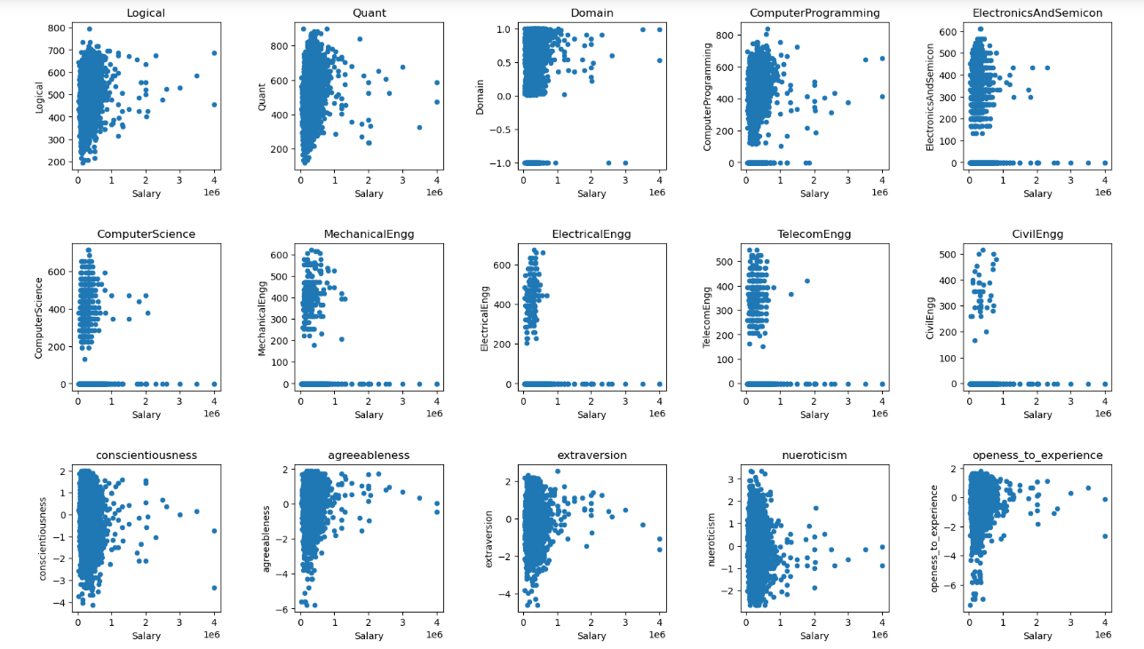
Bivariate Analysis
Observations:
The scatter plots show the relationship between various academic and professional factors and an individual's salary. Some of the factors include college tier, college GPA, city tier, English score, domain of study, conscientiousness, and agreeableness.
There appears to be a positive correlation between college tier and salary. This means that people who went to colleges in higher tiers tend to earn more money than people who went to colleges in lower tiers.
There also appears to be a positive correlation between college GPA and salary. This means that people with higher GPAs tend to earn more money than people with lower GPAs.
The relationship between city tier and salary is less clear. There seems to be a positive correlation for some data points, but there are also many outliers.
There is no clear correlation between English score and salary. The data points are scattered evenly across the plot.
There appears to be a positive correlation between domain of study and salary. People who studied computer programming and electronics seem to earn more money than people who studied other domains.
There is no clear correlation between conscientiousness and salary or agreeableness and salary. The data points are scattered evenly across the plots.

Slide 6
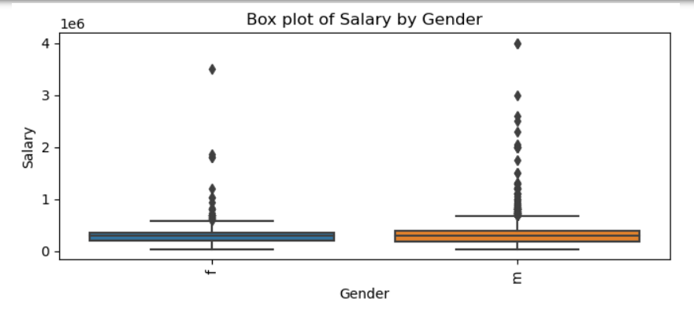
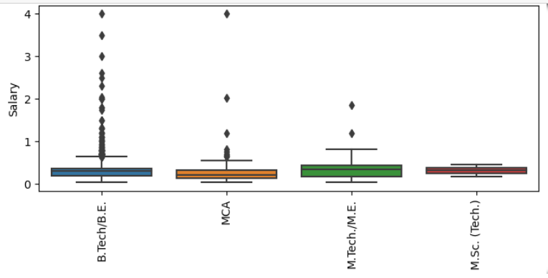
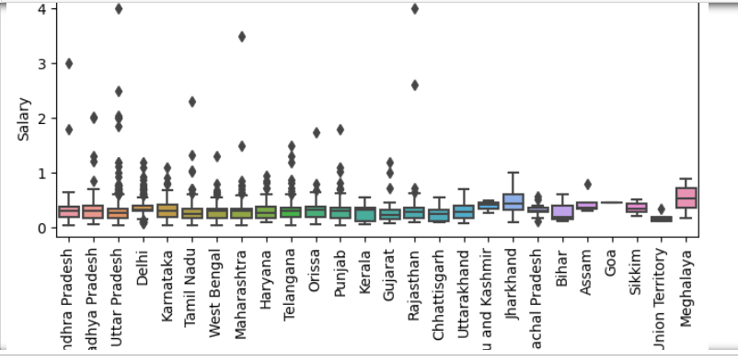
Bivariate Analysis
Observations:
From the above graphs, we can observe the relationship between salary and gender, degree, specialization, and college state of the individual.
Most of the individuals identified as 'Male' have the highest salary of 4000000, compared to females who have the highest salary range between 3000000 and 4000000.
There are many outliers indicating extreme salaries for certain male and female individuals.
Individuals with a B.Tech/B.E. degree have the highest salaries, followed by MCA and M.Tech./M.E. graduates. M.Sc. graduates * tend to have the lowest salaries.
Within the engineering field, individuals with a B.Tech/BE in computer engineering, followed by computer application graduates, have the highest salaries.
Individuals who pursued their degrees in colleges in Uttar Pradesh have the highest salaries, followed by those in Rajasthan and Andhra Pradesh.

Slide 7
Testing Claims and Relationships
1. Salary Claim Testing:
Claim: "After doing Computer Science Engineering, graduates in certain roles can earn up to 2.5-3 lakhs.“
Programmer Analyst:
Result: Reject Null Hypothesis
There is sufficient evidence to support the claim.
Software Engineer:
Result: Reject Null Hypothesis
There is sufficient evidence to support the claim.
Hardware Engineer:
Result: Do Not Reject Null Hypothesis
Inconclusive evidence for the claim.
Associate Engineer:
Result: Do Not Reject Null Hypothesis
The claim is not supported by the data.
2. Gender and Specialization Relationship Testing:
Claim: "There is no relationship between gender and specialization."
Result: Reject Null Hypothesis
There is a statistically significant relationship between gender and specialization.
Key Takeaways:
Programmer Analysts and Software Engineers likely earn salaries in the claimed range.
Hardware Engineers and Associate Engineers' salaries do not support the claim.
Gender and specialization show a significant relationship, suggesting gender preference in certain fields.

Slide 8
Conclusion
The dataset represents a wide range of salaries with a significant number of outliers, indicating diverse income levels.
Educational performance varies moderately, with some individuals scoring lower in 10th and 12th percentages.
Personality traits are diverse, with varying levels of conscientiousness, agreeableness, extraversion, neuroticism, and openness.
There is a notable gender imbalance, especially in degree choices and college states.
Positive correlations exist between salary and factors like college tier, GPA, and domain of study.
However, there are no clear correlations between salary and English score, or personality traits like conscientiousness and agreeableness.
The dataset reflects the diversity in educational backgrounds, career paths, and gender representation within the sampled population.

Slide 9

THANK YOU

